Slide 1
Physical Properties

Slide 2

By the end of this lesson, you should be able to:
Name and describe the different types of physical properties.
Identify the physical properties of a given substance.

Slide 3

I'd like you to imagine making a cake.
First you mix all of the ingredients together to make a batter. Then you bake the cake.
In both cases, you do things that change how the cake looks, smells, feels and, especially, tastes.

Slide 4

A cake is made by mixing ingredients together in a step-by-step process.
Making a cake takes flour, sugar, eggs, baking powder and other ingredients. These ingredients must be added together and mixed in a specific sequence.
Each step changes aspects of the ingredients. The final cake is very different to the flour you started with. So what has happened?

Slide 5
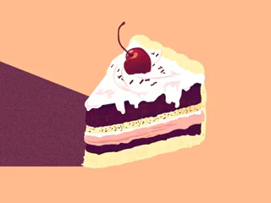
Each added ingredient changes the properties of the cake.
A property is a feature that a substance has. There are many different types of properties.
In our cake example, ingredients are chosen for their properties. Eggs are sticky and so can bind the batter of a cake together. Sugar is sweet, so it makes the cake taste sweeter.

Slide 6
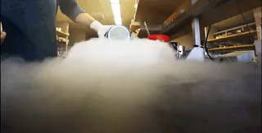

Scientists divide properties into physical and chemical.
Physical properties can be detected by our senses, or otherwise describe the way that a substance is.
Chemical properties describe the way that a substance can change into another substance.

Slide 7
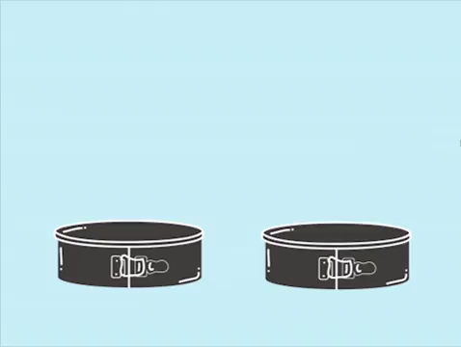
Doing things to a substance can change its properties.
If you change a physical property - for example, melting ice to make it liquid water - then we call it a change.
If you change a chemical property to make a new substance, this is called a reaction. Burning coal and baking a cake are examples of chemical reactions, because new substances are being created.

Slide 8
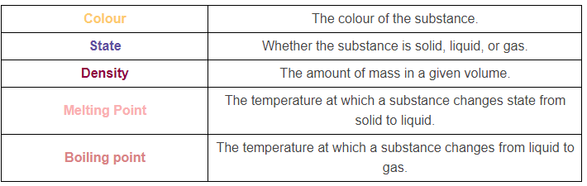
Here are the physical properties we've learned about so far:

Slide 9

We can also describe how hard a substance is without changing a substance's chemical identity.
Hardness describes how resistant a substance is to a change in shape when a force is applied to it.
Less force is required to scratch or indent a softer substance than a harder substance.

Slide 10
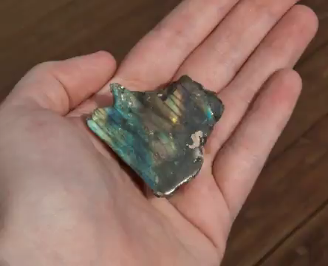
Lustre is a physical property that describes how light is reflected off the surface of a substance.
If a substance does not appear shiny or radiant, it is said to have a dull lustre or little to no lustre.
There are many different ways to describe the lustre of shiny, reflective substances. We can generally describe them as having high lustre or being lustrous.

Slide 11

Ductility is a physical property that describes whether or not a substance can be drawn into a wire.
A material is described as ductile if it can be drawn into a wire without breaking.
If a material is unable to be drawn into a wire, it is referred to as brittle.

Slide 12

Malleability is a physical property that describes a substance's ability to change shape under pressure.
If a substance is malleable, it is able to be hammered, bent or rolled into new shapes without breaking.
A substance that breaks under these pressures is described as non-malleable.

Slide 13
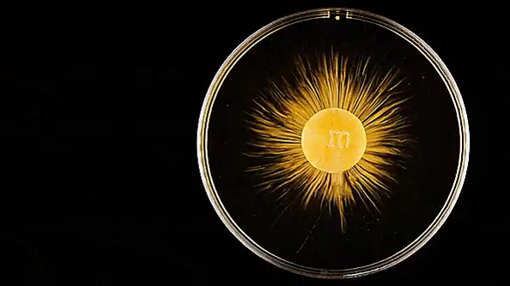
Solubility is a physical property that describes a substance's ability to dissolve in a given volume of solvent.
A solvent is the substance that a solute is dissolved in. A solute is the substance being dissolved.
We describe a substance as highly soluble if it readily dissolves in a solvent.
If a substance is unable to dissolve in a solvent, it is insoluble.

Slide 14
Heat conductivity is a physical property that describes a substance's ability to conduct heat.
If a substance transfers heat very well, it is described as being a good heat conductor.
Poor heat conductors are bad at conducting heat. These materials are also described as thermal insulators.
The two surfaces above are the same temperature, yet the ice on the aluminium (right) melts much faster than the ice on the plexiglass (left). This is because aluminium is a better conductor of heat than plexiglass!

Slide 15

Electrical conductivity is a physical property which describes a substance's ability to carry electrical current.
If electrical current readily flows through a substance, it is described as having good electrical conductivity.
Poor conductors of electricity are substances that resist the flow of electrical current. They are also called electrical insulators.

Slide 16
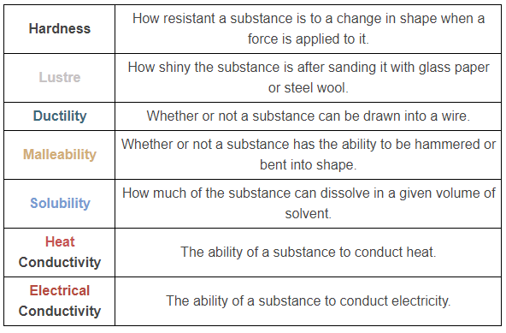
More physical properties summarised:

